Slide 1
Welcome!
Sunday
Bible Study 9:30 AM
Worship 10:30 AM
PM Bible Class (Livestream) 5:00 PM
Wednesday
Bible Class 7:00 PM
www.SunsetchurchofChrist.net

Slide 2
John 8:12
"I AM the light of the world”
I AM the Bread of Life - John 6:35
I AM the Door - John 10:7
I AM the Good Shepherd - John 10:11
I AM the Resurrection and the Life - John 11:25
I AM the Way, the Truth, and the Life - John 14:6
I AM the Vine - John 15:1

Slide 3
John 8:12-20
Testimony of Jesus
He was the Light of the World
Following Him removes darkness
He did not come to judge
John 5:22-27 (?)
John 3:17-19

Slide 4
John 8:21-30
Jesus reveals His goal
Belief in Jesus
Speaking from the Father

Slide 5
Welcome!
Sunday
Bible Study 9:30 AM
Worship 10:30 AM
PM Bible Class (Livestream) 5:00 PM
Wednesday
Bible Class 7:00 PM
www.SunsetchurchofChrist.net

Slide 6
Opening Prayer | Grant Haines
Song – 19 | George Watkins
Scripture Reading | Michael Hetzer
Song – 518 | George Watkins
Song – 186 | George Watkins
Lord’s Supper | Michael Hetzer/ Tacho Montanez
Song – 453 | George Watkins
Collection | Michael Hetzer/ Tacho Montanez
Song – 97 | George Watkins
Lesson | Brian Haines
Song – 319 | George Watkins
Closing | Anthony Ward

Slide 7
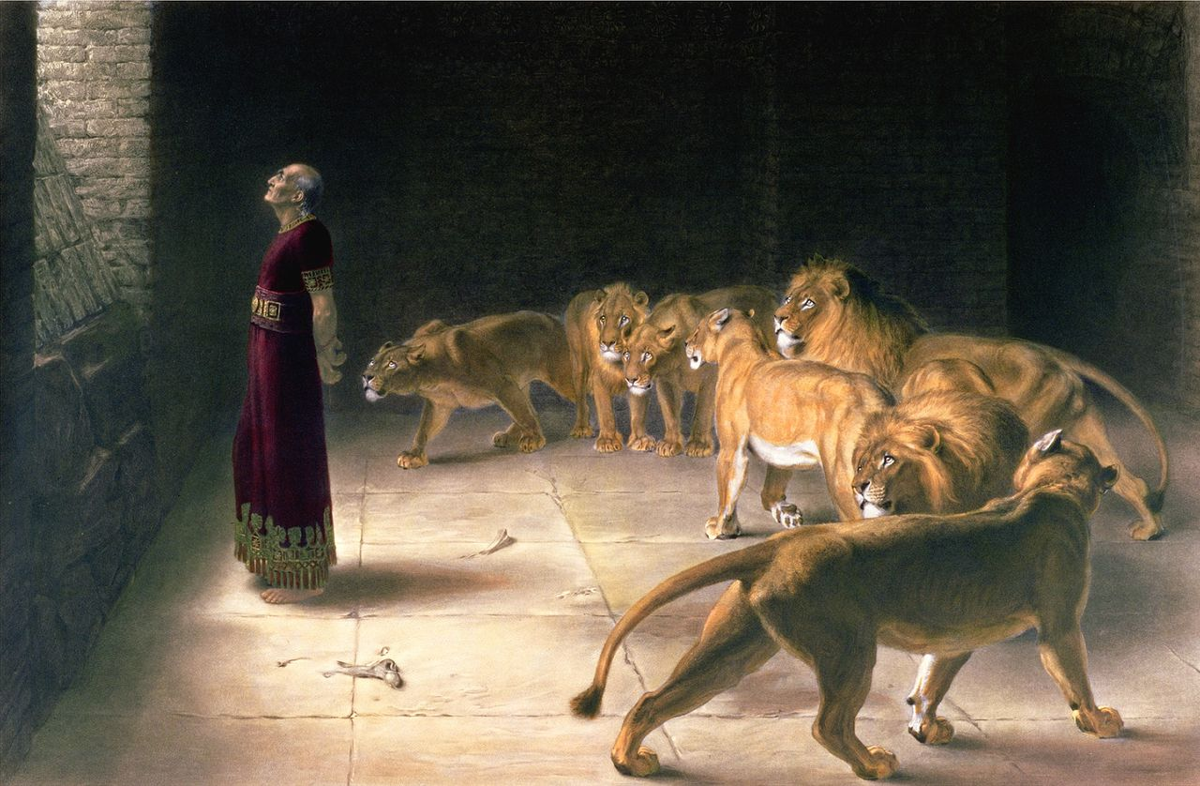
Daniel 6

Slide 8
No Compromise
Daniel 1 – NO COMPROMISE on foods
Daniel 3 – NO COMPROMISE on idols
Daniel 5 – NO COMPROMISE on truth
Daniel 6 – NO COMPROMISE on prayer

Slide 9
The Divine Command
"Render therefore to Caesar the things that are Caesar's, and to God the things that are God's.“ Matthew 22:21

Slide 10
The Divine Command
Therefore submit yourselves to every ordinance of man for the Lord's sake, whether to the king as supreme, or to governors, as to those who are sent by him for the punishment of evildoers and for the praise of those who do good. 1 Peter 2:13-14

Slide 11
The Divine Command
How do we fulfill this command?
Romans 13:1-8
Taxes
Customs
Fear
Honor

Slide 12
But What About…..
Even when government is corrupt?
Acts 23:1-5
When man’s law crosses God’s law?
Acts 5:29
What does “civil disobedience” look like?
Daniel’s example
Notes:
Ac 23:1 ¶ Then Paul, looking earnestly at the council, said, "Men and brethren, I have lived in all good conscience before God until this day." 2 And the high priest Ananias commanded those who stood by him to strike him on the mouth. 3 Then Paul said to him, "God will strike you, you whitewashed wall! For you sit to judge me according to the law, and do you command me to be struck contrary to the law?" 4 And those who stood by said, "Do you revile God's high priest?“ 5 Then Paul said, "I did not know, brethren, that he was the high priest; for it is written, 'You shall not speak evil of a ruler of your people.'“
Ac 5:29 But Peter and the other apostles answered and said: "We ought to obey God rather than men.

Slide 13
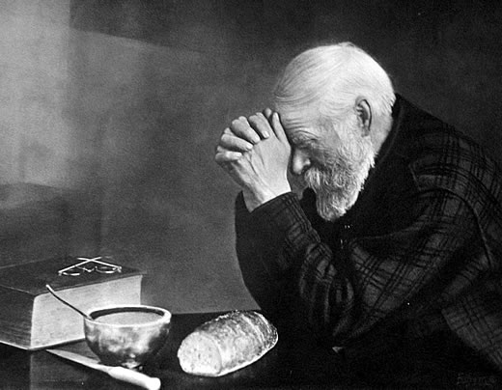
Daniel’s Civil Disobedience
An absence of malice
An absence of subterfuge
An absence of rebellion
Notes:
https://upload.wikimedia.org/wikipedia/commons/a/a2/Eric_Enstrom_-_Grace_-_bw.jpg

Slide 14
Discerning the Line
When it is man’s law vs. God’s law:
We must obey God and not man
We must worship
We must speak the truth
We must abide in the doctrine

Slide 15
Discerning the Line
When it is man’s law vs. God’s law:
We must obey God and not man
We are not permitted to rebel
Our liberties are in Christ
Our loyalty is to Him

Slide 16
Discerning the Line
When it is man’s law vs. God’s law:
We must obey God and not man
We are not permitted to rebel
We trust God will deliver us
He is our defender
He is our hope

Slide 18
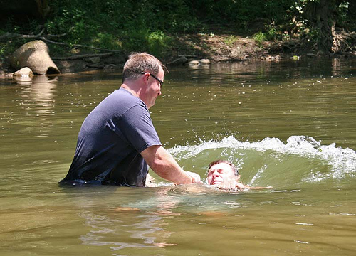
"He who believes and is baptized will be saved; but he who does not believe will be condemned. Mr 16:16
Song 319
Notes:
Ac 15:11 "But we believe that we are saved through the grace of the Lord Jesus, in the same way as they also are."

